Slide 1

Optimization Algorithms
Gradient descent with momentum
deeplearning.ai

Slide 2
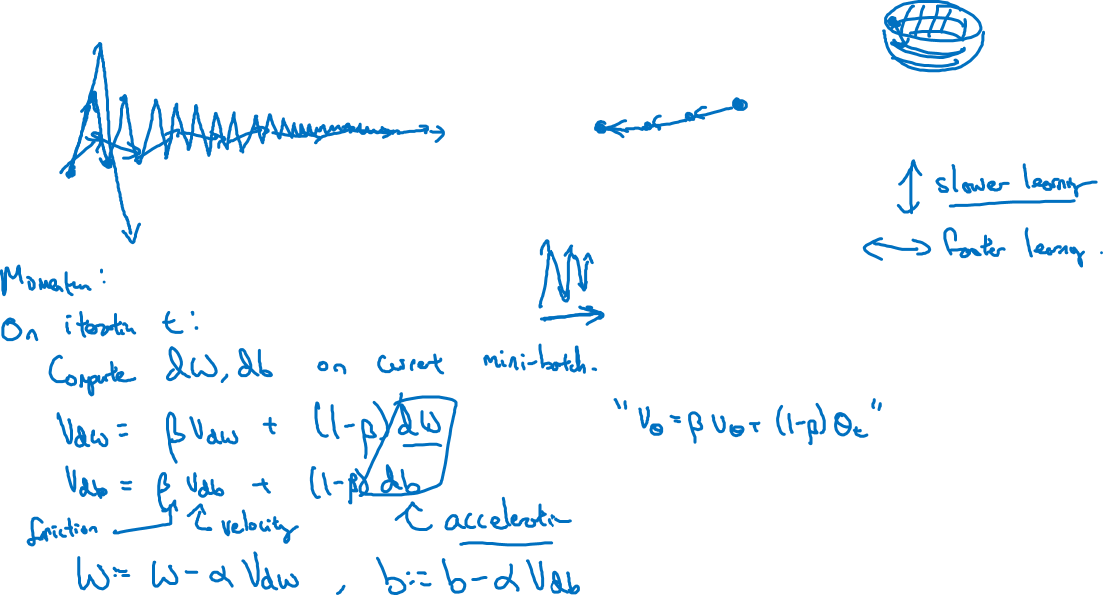
Gradient descent example

Slide 3
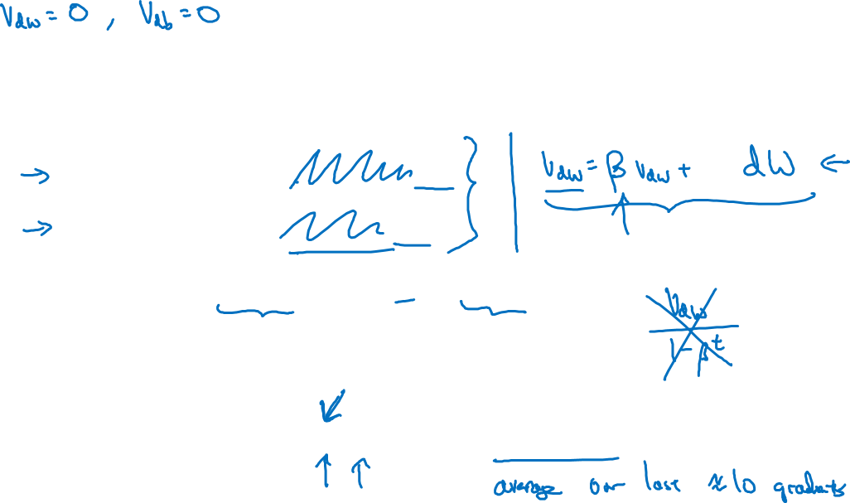





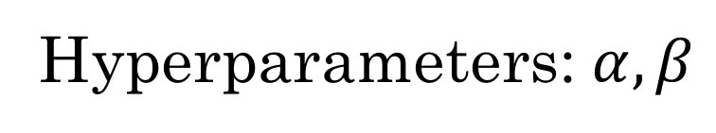

Implementation details

